Slide 1



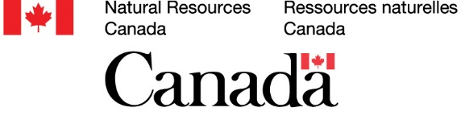
SpaDES
a flexible tool to PERFICT your workflow
Tati Micheletti, Eliot McIntire, Ceres Barros, Alex Chubaty, Frances Stewart, Ian Eddy, Celine Boisvenue, Steve Cumming, and many others…

Slide 2
SpaDES and the PERFICT principle
Opening black-boxes, revealing secret-handshakes, and
making sure you can do it all over again

Slide 3
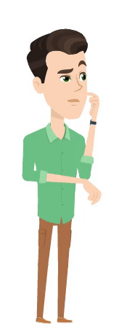



SpaDES and the PERFICT principle
Once upon 20 years ago…
best tool to make spatio-temporal simulation models
SELES

Slide 4


SpaDES and the PERFICT principle
Once upon 20 years ago…
best tool to make spatio-temporal simulation models
tool to make simulation models that is paradigm-free, and easy for ecologists to learn and use

Slide 5

SpaDES and the PERFICT principle
Once upon 20 years ago…
best tool to make spatio-temporal simulation models
tool to make simulation models that is paradigm-free, and easy for ecologists to learn and use
Parameter Estimation
R³
Uncertainty
Dr. McIntire
Dr. Chubaty

Slide 6

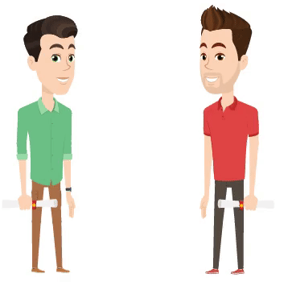
SpaDES and the PERFICT principle
Once upon 20 years ago…
best tool to make spatio-temporal simulation models
tool to make simulation models that is paradigm-free, and easy for ecologists to learn and use
Parameter Estimation
R³
Uncertainty
Aug 2017: SpaDES in CRAN
Notes:
But along the way, the group realized that a bigger issue was actually not just "simulation"; but consistent parameter estimation, and therefore, they needed to bring estimation and simulation together. Soon after, they realized that reproducibility was the new challenge they needed to address, which led to understanding they also needed reusability and a way for researchers to more easily use each other's code. With that, the question of model uncertainty also came up, and with it, the need to run many models together, not just their own. SpaDES then evolve to be able to tackle all of these problems, and more. It is based on modularity of code components, some of which are dynamic, some GIS, some parameterization, some written in other languages, and some written by other people.

Slide 7
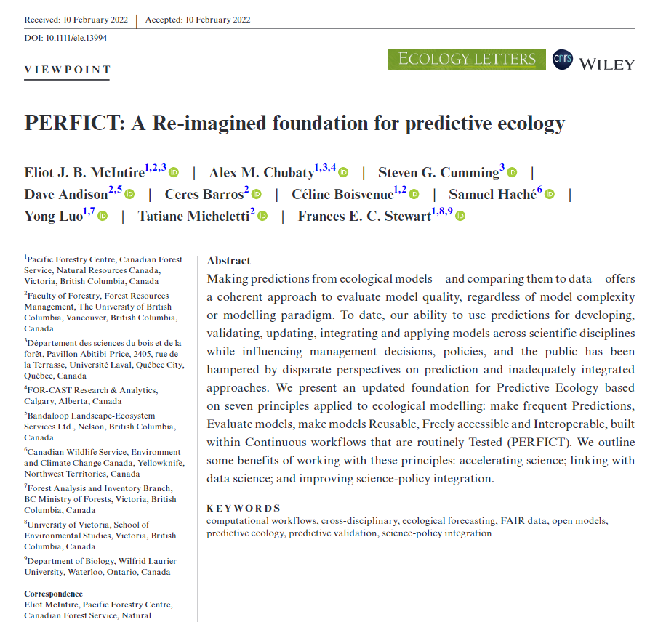
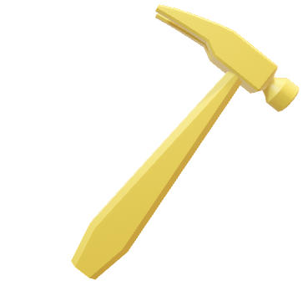
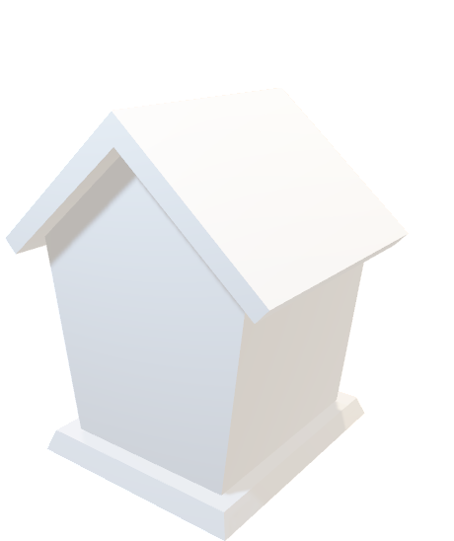
SpaDES and the PERFICT principle
PERFICT
Make Predictions, Evaludate models, make models Reusable, Freely accessible and Interoperable, built within Continuous workflows that are routinely Tested
SpaDES
PERFICT

Slide 8
How can SpaDES speed-up scientific development?
The story of the caribou, the songbirds, and
their connection to wildlife management

Slide 9

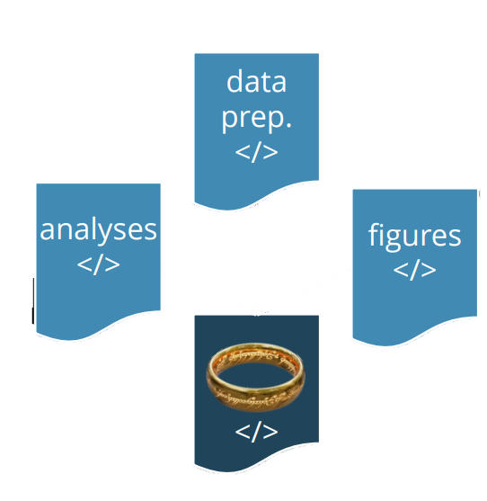
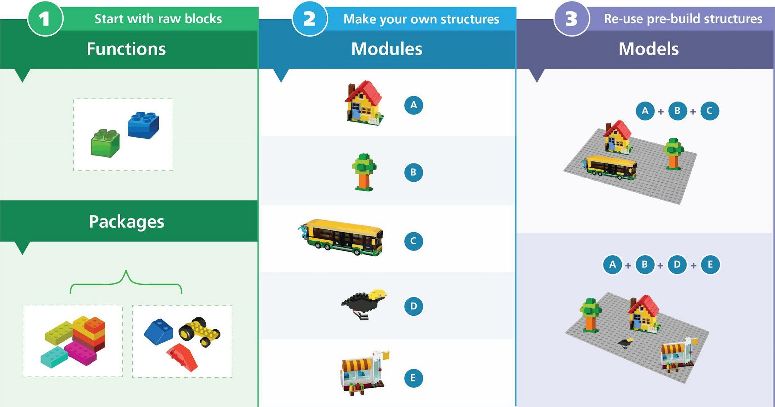
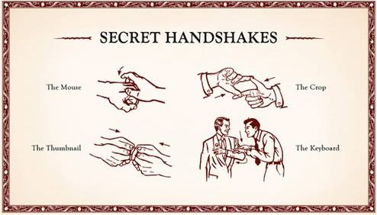
Speeding-up science
Centralized workflow: one single script to rule them all, and in the darkness bind them
Script: code and metadata together in one language
Modularity: reusable code and models

Slide 10

Speeding-up science
Wildfire
Models
Forest Growth
and succession
Models
Climate
Models
Wildlife
Models

Slide 11
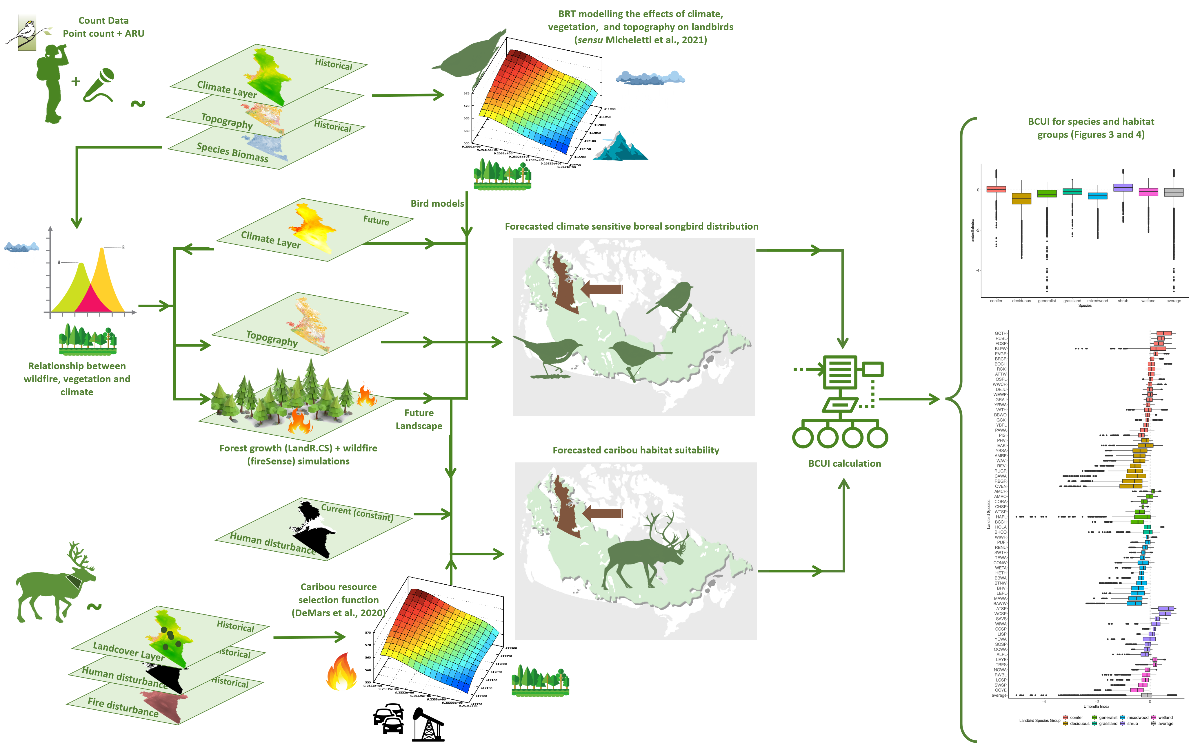
Micheletti et al., 2021
1. With which mechanism will climate change impact boreal landbirds?
1

Slide 12
Raymundo et al., 2024
2. How will boreal landbird abundance and distribution change throughout the century?
2

Slide 13
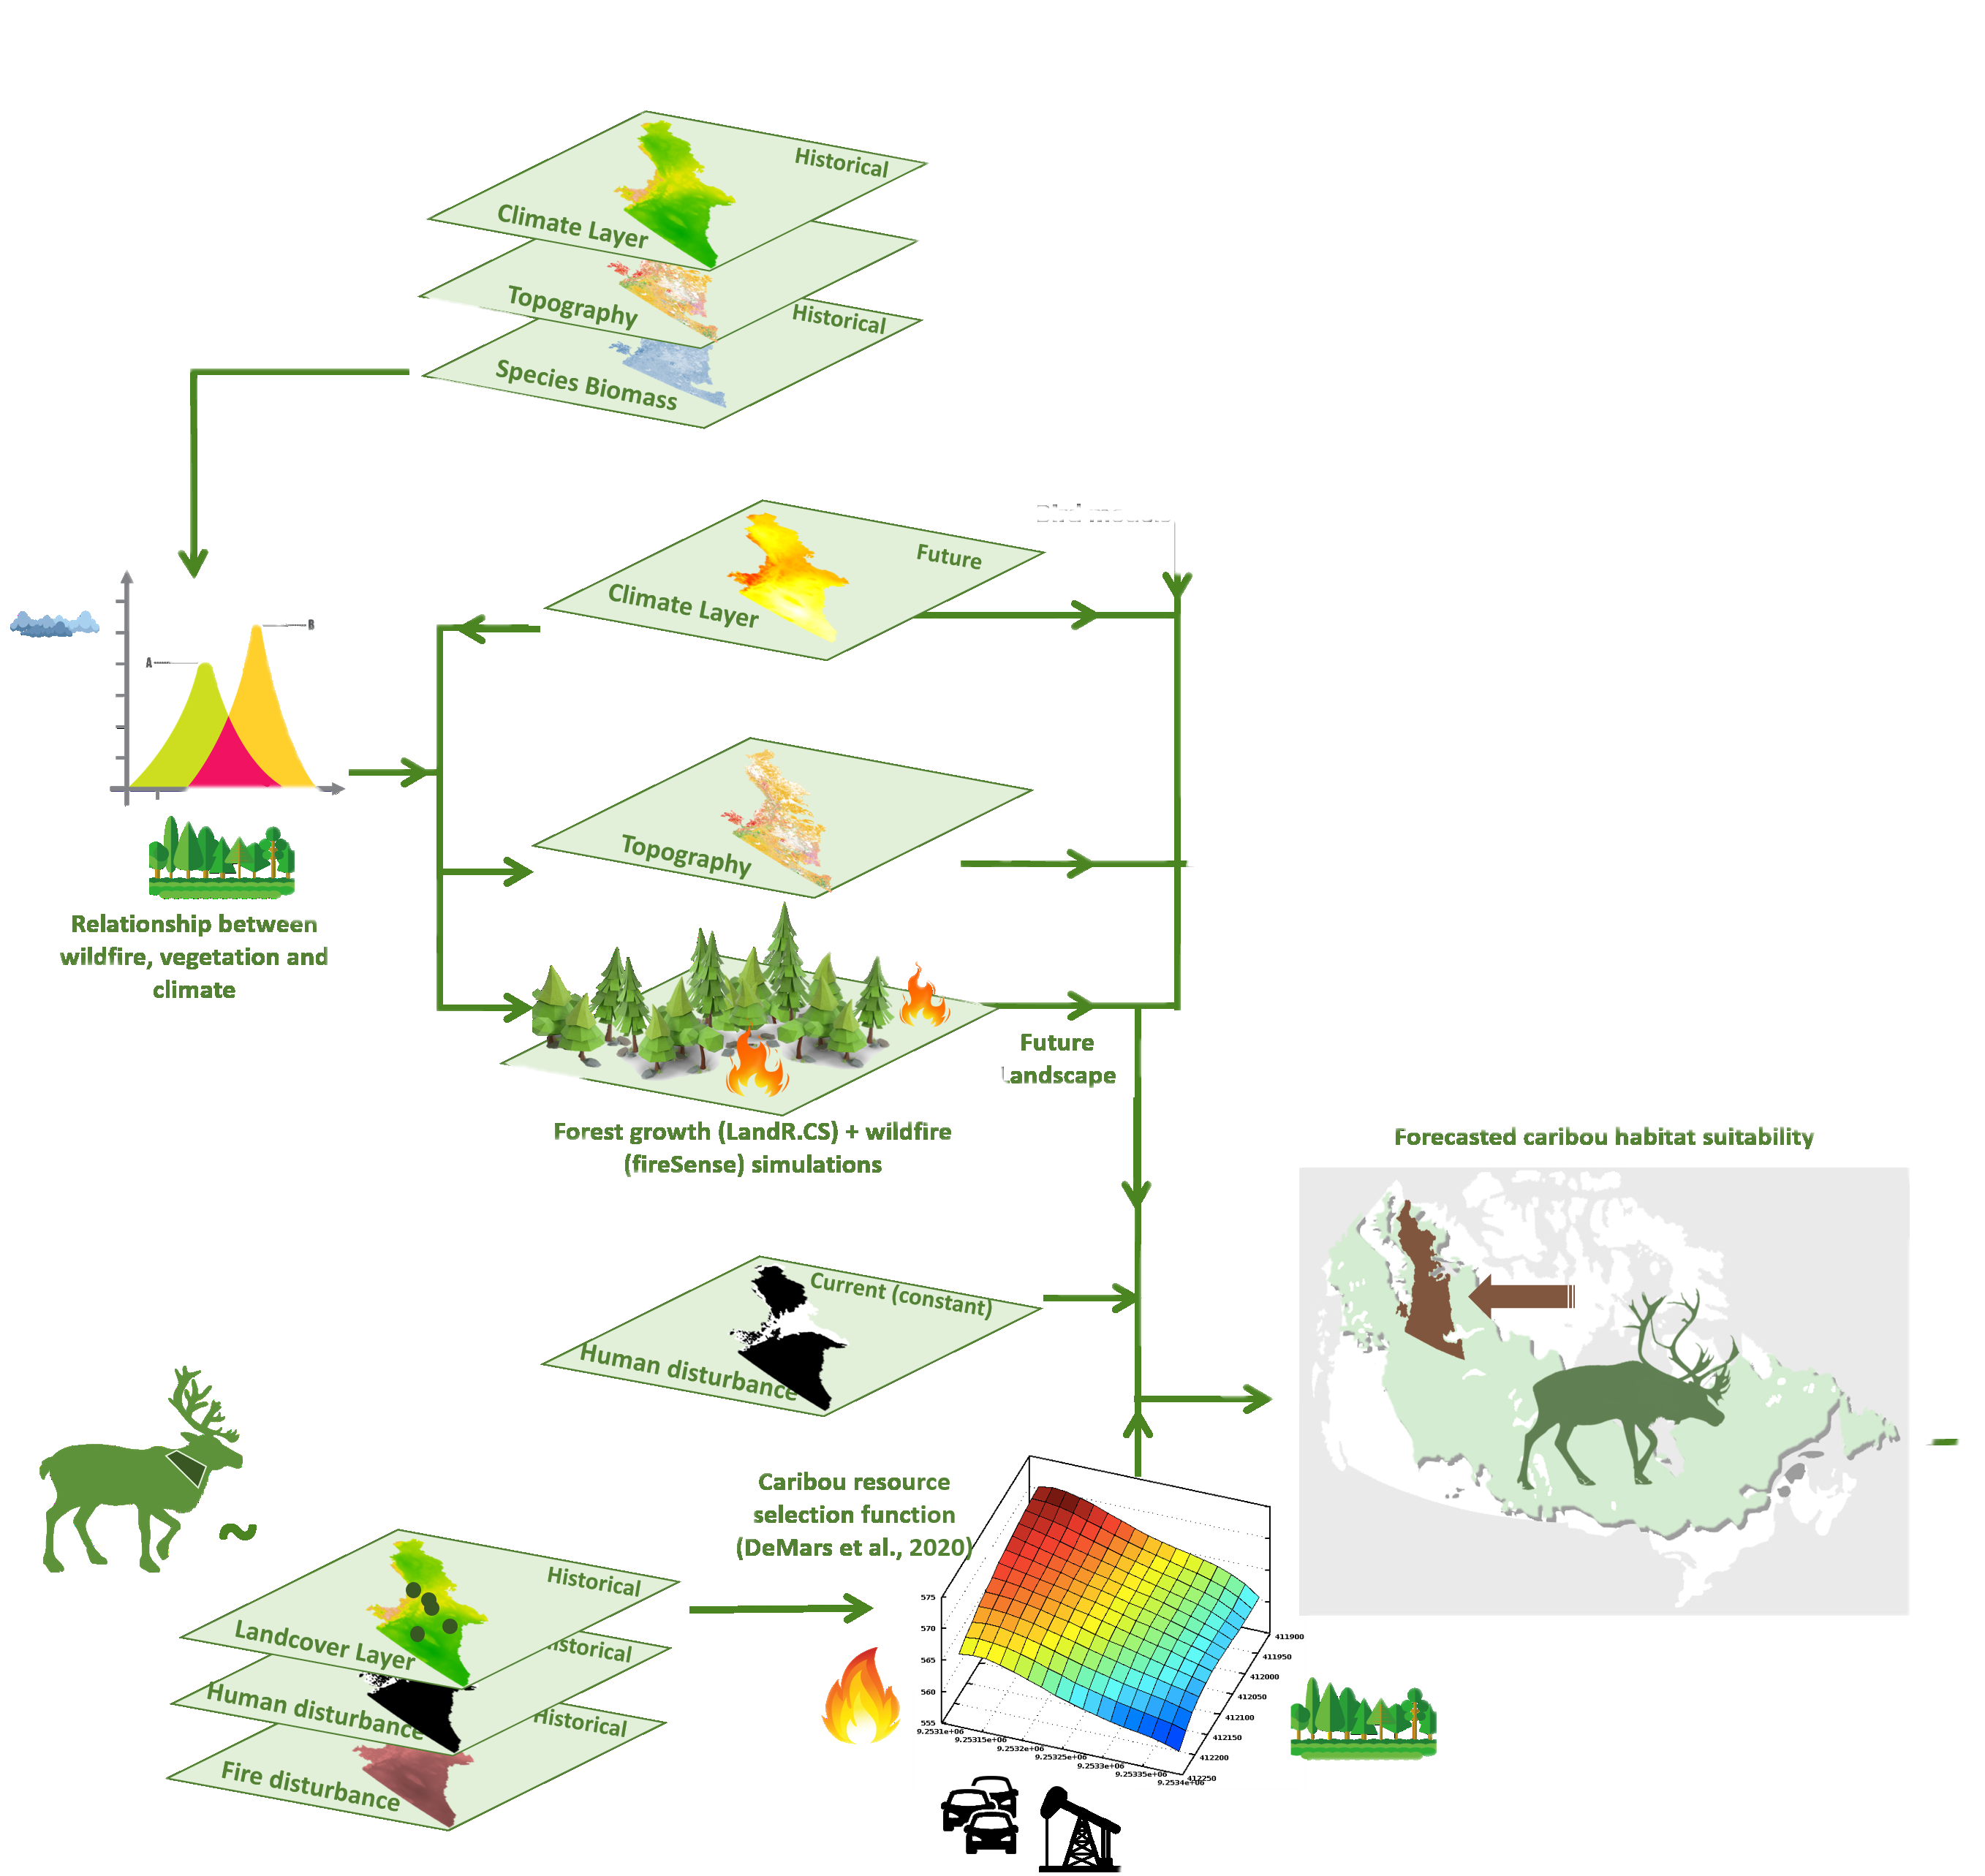
Stewart et al., 2023
3. How will climate change impact boreal caribou?
3

Slide 14
Micheletti et al., 2023
4. Are there synergies for boreal caribou and landbird conservation?
4

Slide 16
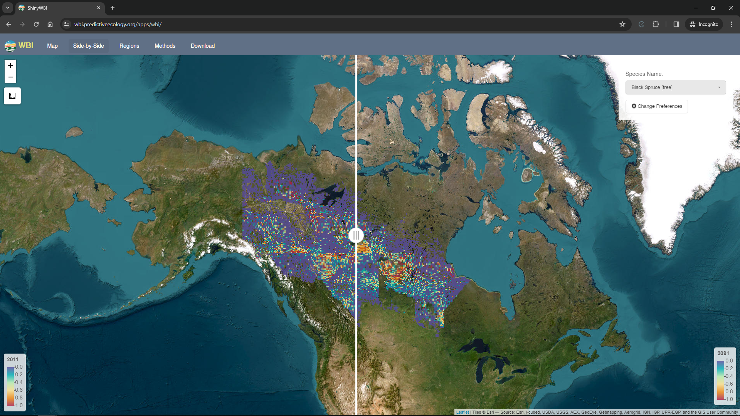

Slide 17
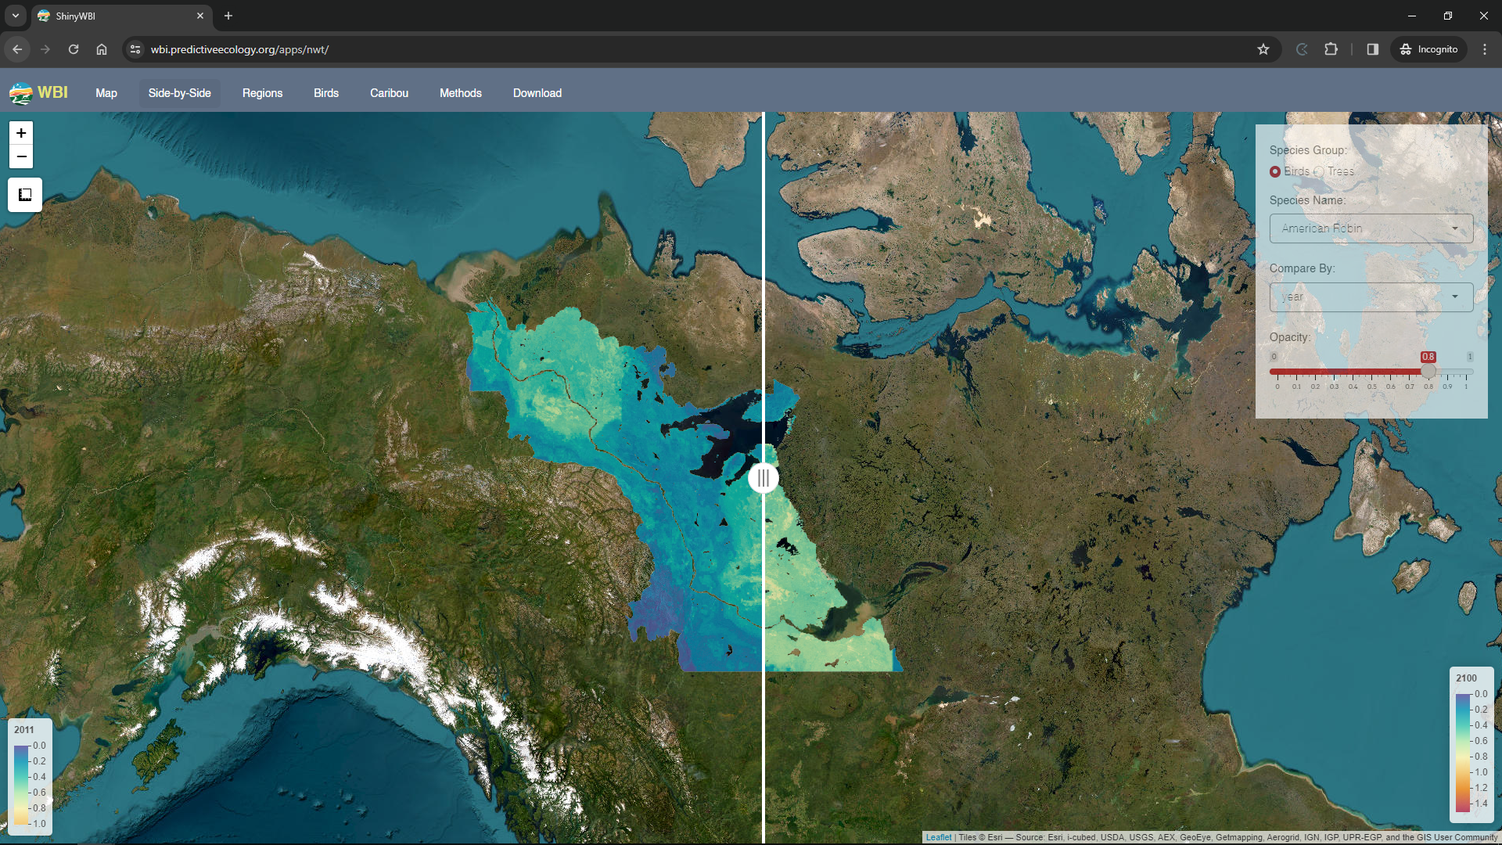

Slide 18
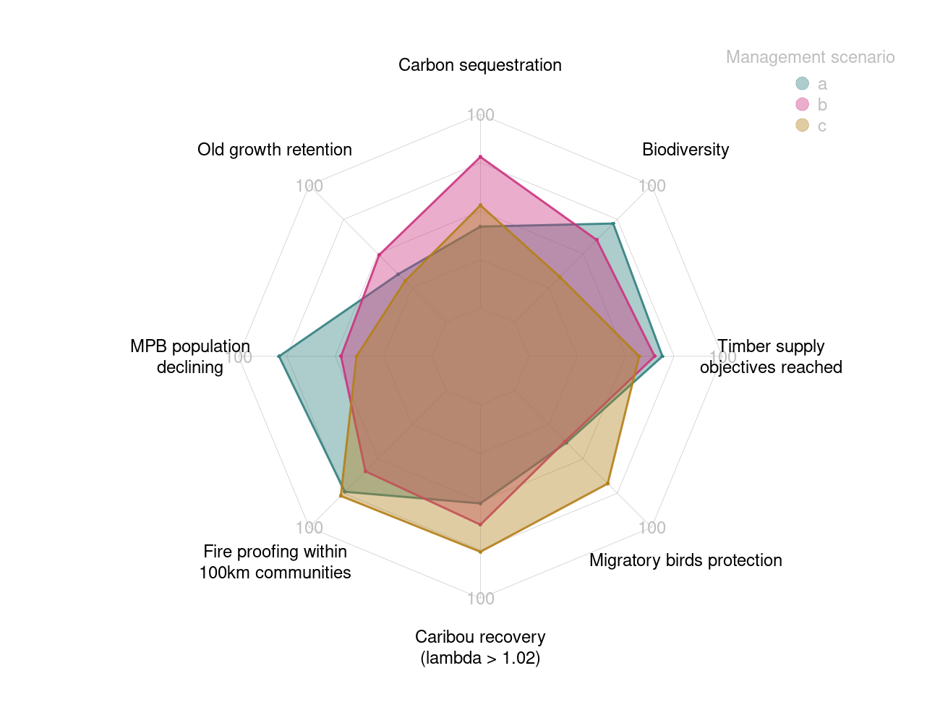
Speeding-up science

Slide 19
What does SpaDES look like?
Going beyond a scary template

Slide 20

What does SpaDES look like?
SpaDES compatible modules:
Metapackage:
SpaDES.core
SpaDES.tools
reproducible
quickPlot
module
Templated Module’s Manual: module.Rmd
Functions’ folder: R/
Tests folder: tests/
Data folder: data/
README: README.md
NEWS: NEWS.md
Citation: citation.bib
LICENSE: LICENSE.md
Templated script constituted of 3 Main Parts
(plus potential functions): module.R
Objective: support the creation of
SpaDES compatible modules
and orchestrate their
interactions

Slide 21
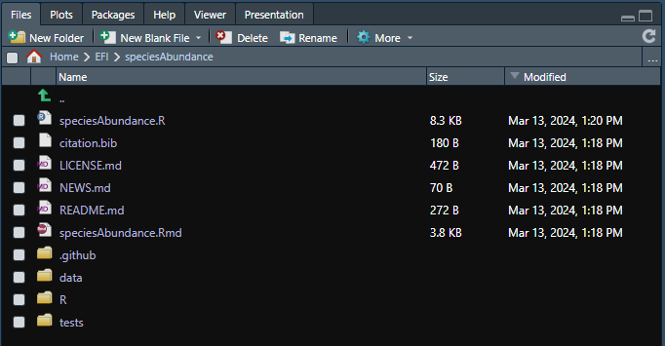
What does SpaDES look like?
SpaDES module:
speciesAbundance
Templated script constituted of
3 Main Parts
Citation file
License file
News file
README file
Manual file
Data folder
R folder
Tests folder

Slide 22
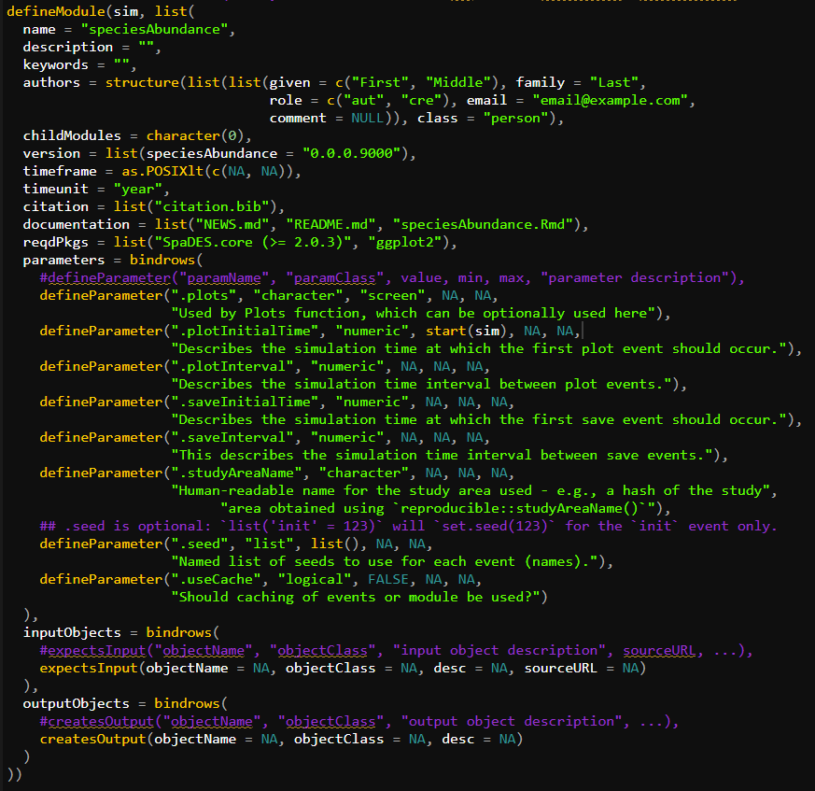
What does SpaDES look like?
speciesAbundance
PART 1: Metadata
defineModule()
Descriptive
Metadata
Functional
Metadata

Slide 23
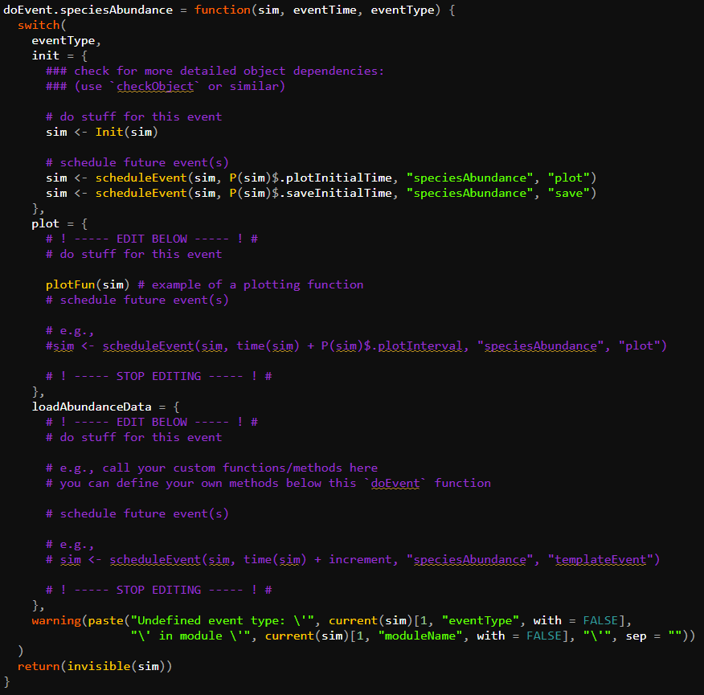
What does SpaDES look like?
speciesAbundance
PART 2: Events
doEvent.module()

Slide 24
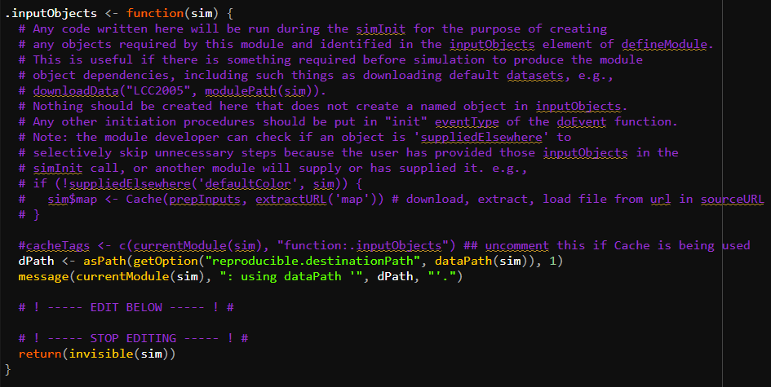
What does SpaDES look like?
speciesAbundance
PART 3: Defaults
.inputObject()

Slide 25
All Hands on Deck!
Creating and integrating simple models with SpaDES’ help

Slide 26
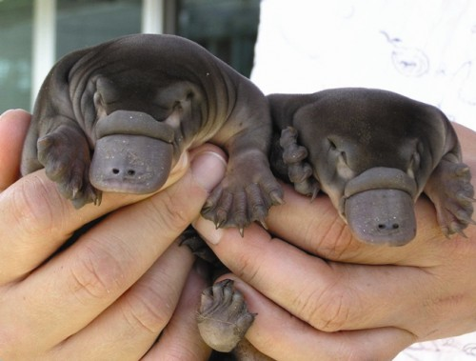
All Hands on Deck!
OBJECTIVE:
Integrate 3 SpaDES compatible modules: how does platypus’ abundance changes over time and in function of water temperature?
TASKS:
Create one module from scratch: speciesAbundance
Get the other two modules made by someone else:
temperature and speciesAbundTempLM
3. Integrate them and answer the question.
DISCLAIMER: this is a made up exercise! All I know about platypus is that they are adorable.
Notes:
But along the way, the group realized that a bigger issue was actually not just "simulation"; but consistent parameter estimation, and therefore, they needed to bring estimation and simulation together. Soon after, they realized that reproducibility was the new challenge they needed to address, which led to understanding they also needed reusability and a way for researchers to more easily use each other's code. With that, the question of model uncertainty also came up, and with it, the need to run many models together, not just their own. SpaDES then evolve to be able to tackle all of these problems, and more. It is based on modularity of code components, some of which are dynamic, some GIS, some parameterization, some written in other languages, and some written by other people.

Slide 27
With great power comes great...
number of edge cases!
We need user’s help to improve SpaDES and make it even more useful!
Notes:
SpaDES is an amazing and flexible tool, but to have this amount of flexibility we need to understand that hitting errors and finding edge cases happens more frequently than with inflexible software. Our aim is to building science together: let us know how it is broken, and we will try to fix it with you!

Slide 28
Confirm it has the expected format
Converts to spatially explicit
Add raster to final raster stack
Fit a linear model to test if abundance is changing through time
Plotting
First year
Every year
Last year

